Slide 1

Cyclistic Bike Share Data Analysis
Insights & Recommendations
Prepared by Altamash Ali

Slide 2
Introduction
Cyclistic, a bike-share company in Chicago, aims to increase its number of annual memberships. This report examines the differences in usage patterns between annual members (or subscribers) and casual riders, with the goal of identifying opportunities to convert casual riders into members.

Slide 3
Business Task
Determine how annual members and casual riders use Cyclistic bikes differently, providing insights to inform a marketing strategy aimed at increasing annual memberships.

Slide 4
Executive Summary
Overview of data analysis focusing on ride patterns by user type.
Key differences observed between casual riders and members.
Actionable recommendations derived from findings.

Slide 5
Data Source
The data was obtained from the Divvy Tripdata Archive.
This analysis uses the ‘Divvy Stations Trips 2013‘ dataset, which covers the complete ride history for 2013. The public dataset excludes personally identifiable information and has been validated for completeness and accuracy.

Slide 6
Data Preparation & Processing
1) Added new calculated fields:
Ride length (HH:MM:SS)
Day of week (as numbers 1=Sunday to 7=Saturday)
Month
Day Name
Hour
Custom (Ride Duration Bucket)
2) Formatted data to their data types.
3) The data was verified to contain no duplicates.

Slide 7
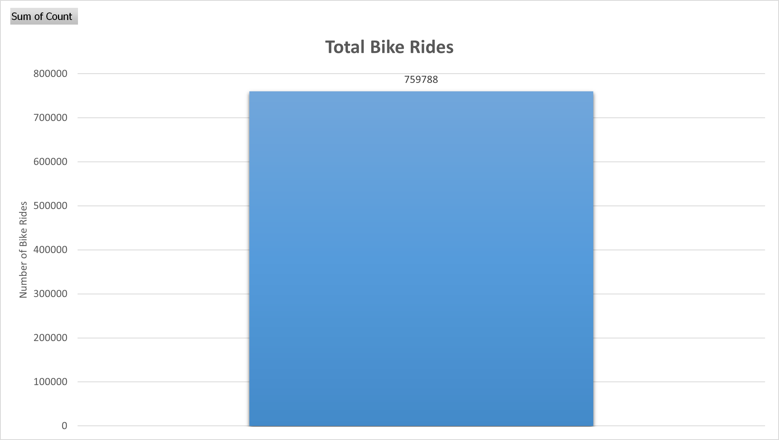

Slide 8
Observed Trends / Key Insights:
Total Number of Rides : 759788.

Slide 9
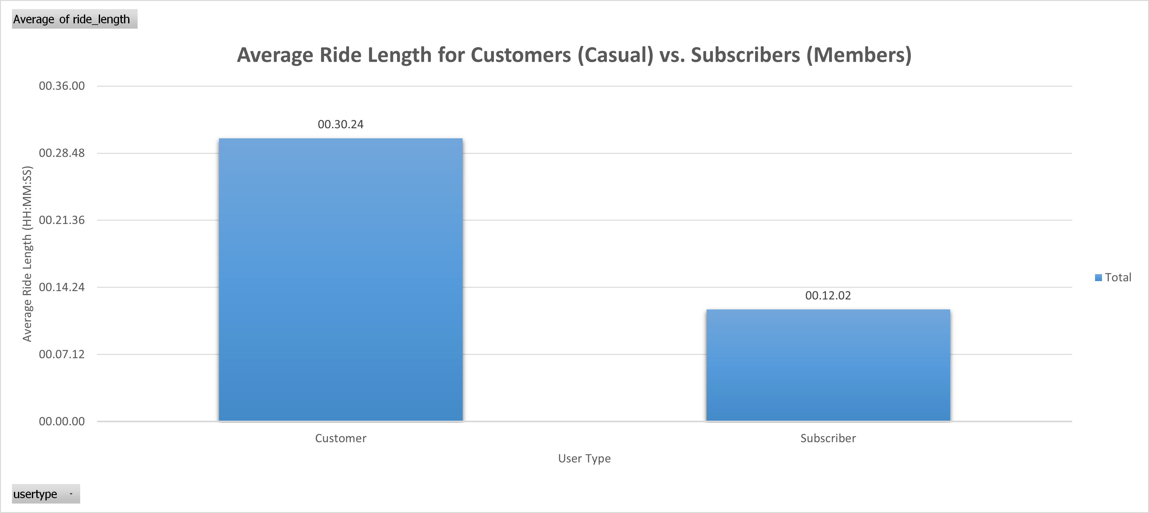

Slide 10
Observed Trends / Key Insights:
Customer ride length : ~ 30 minutes per ride.
Subscriber ride length : ~ 12 minutes per ride.

Slide 11
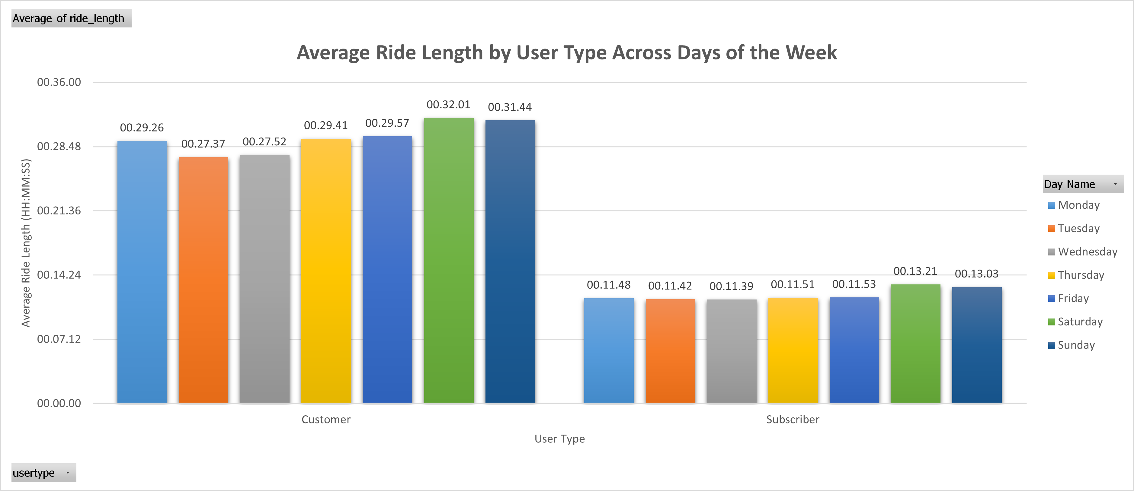

Slide 12
Observed Trends / Key Insights:
Customers’ average weekly ride length :
~ 27 to 32 minutes per ride.
Subscribers’ average weekly ride length :
~ 11 to 13 minutes per ride.

Slide 13
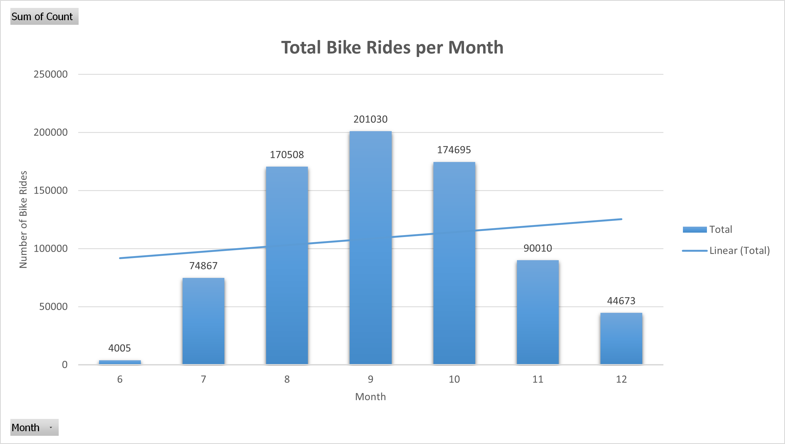

Slide 14
Observed Trends / Key Insights:
The months of August, September, and October had the most number of rides, over 100,000 rides.

Slide 15
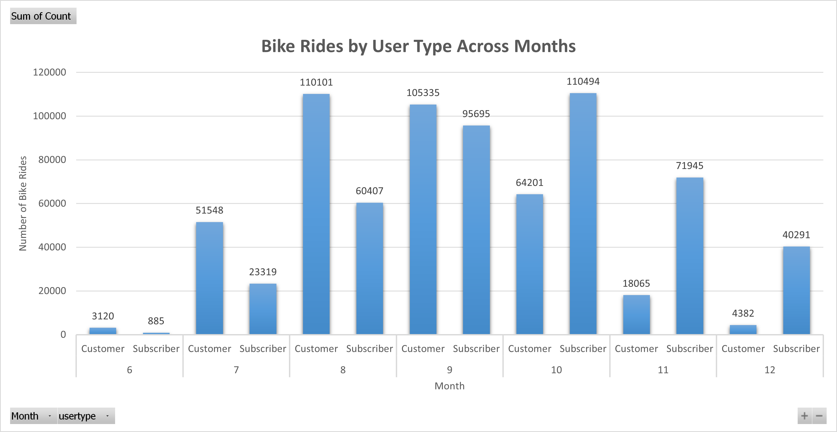

Slide 16
Observed Trends / Key Insights:
Casual rides are higher than subscriber rides between July and September.
Subscriber rides are higher than casual rides between October and December.

Slide 17
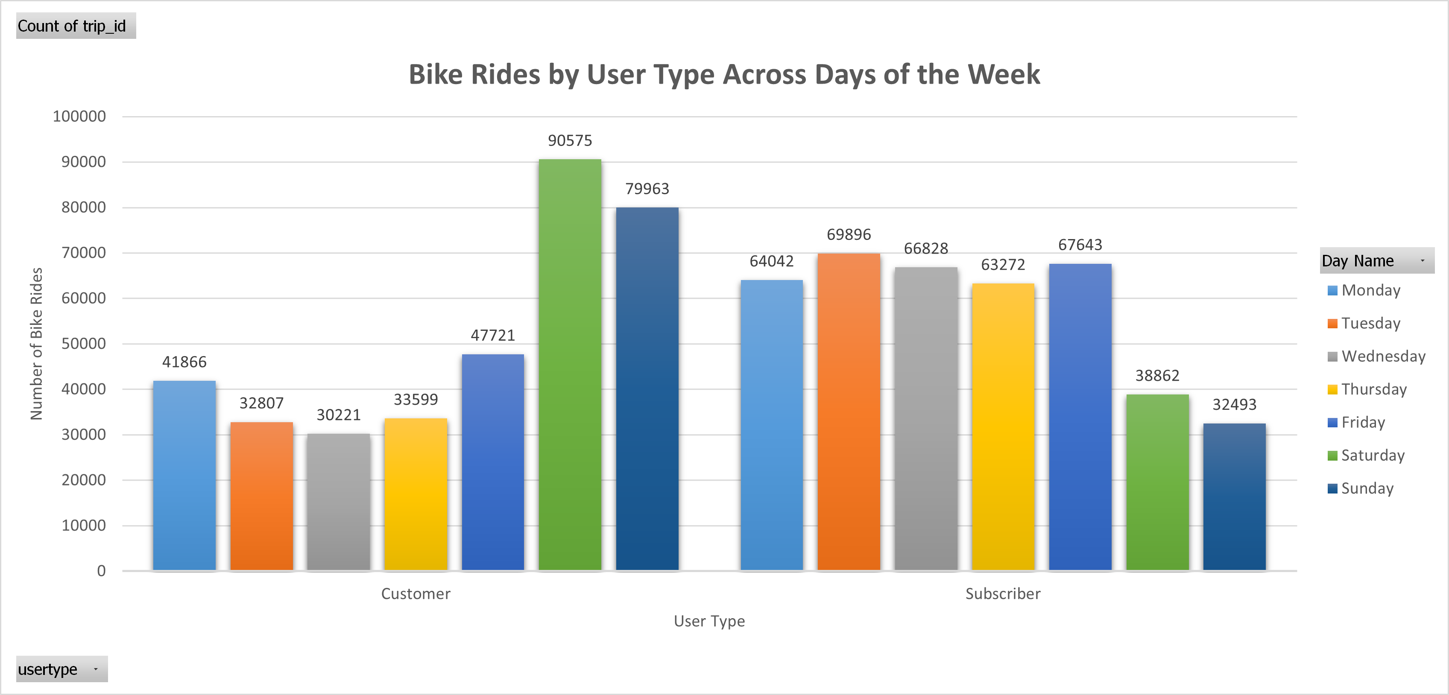

Slide 18
Observed Trends / Key Insights:
Casual customers have a high volume of bike rides during the weekends. This suggests that casual bike rides could be for leisure or for tourism purposes.
Members or subscribers have a high volume of bike rides during the weekdays. This suggests that they are regular commuters who are either students or go to work.

Slide 19
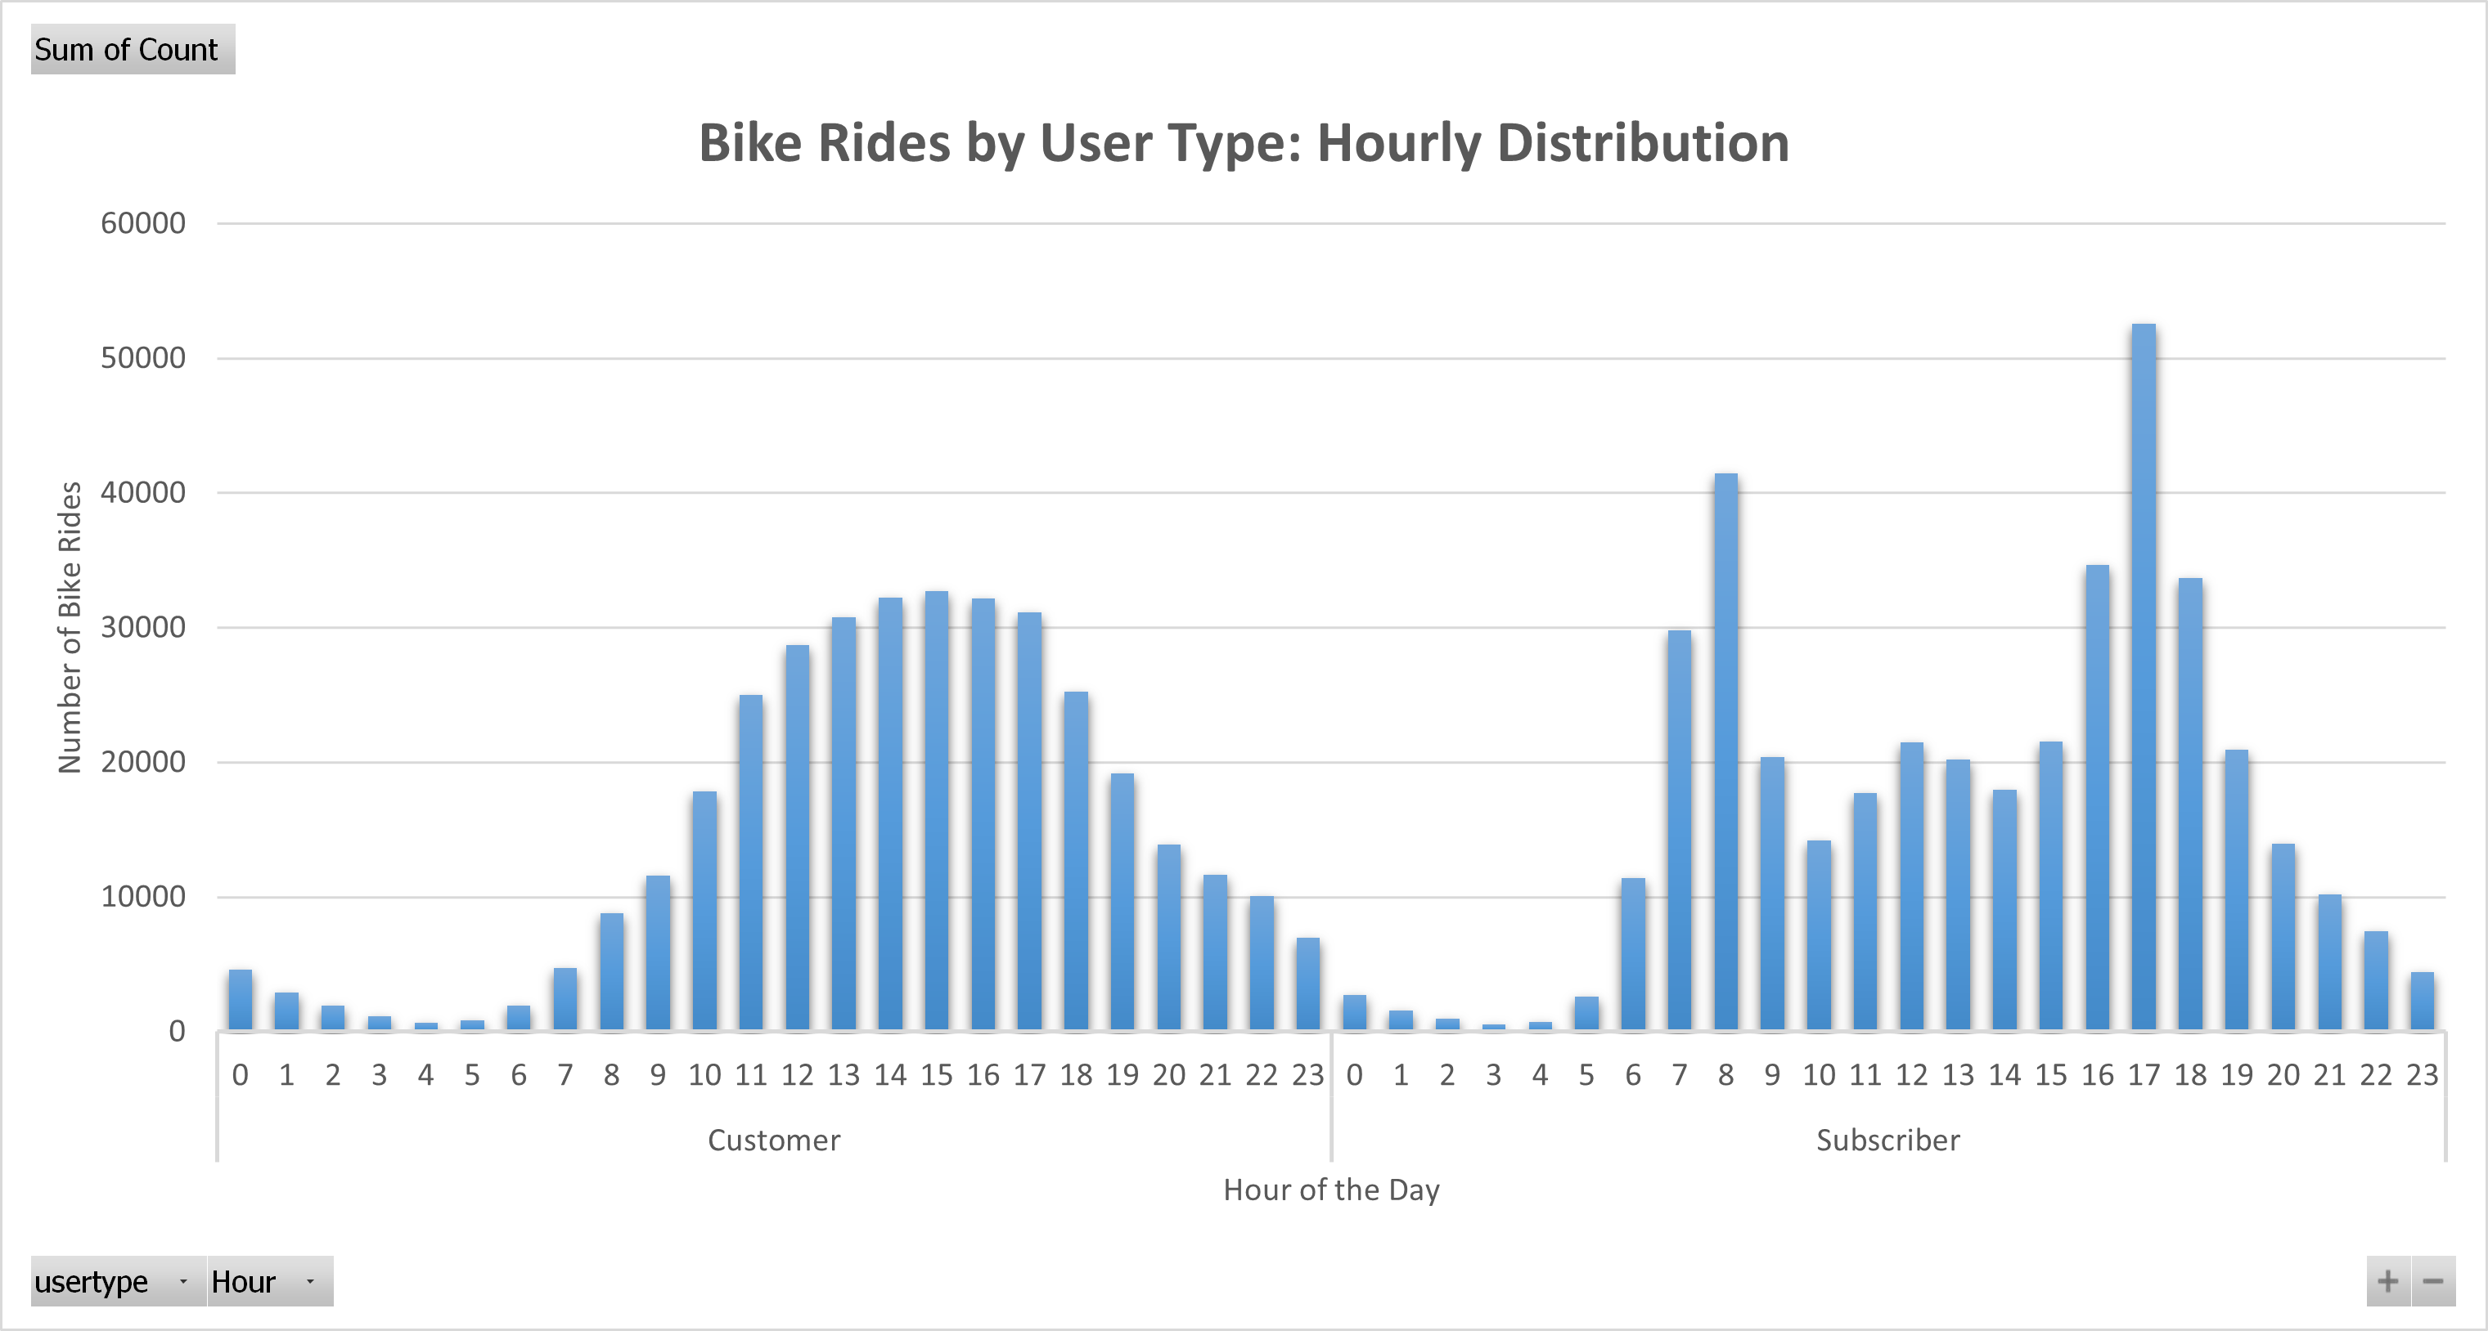

Slide 20
Observed Trends / Key Insights:
For casual customers:
The number of rides peaks between 1 and 5 pm.
For subscribers:
The number of rides peaks between 7 and 9 am and again between 3 and 7 pm. This supports the postulation that subscribers are regular commuters—likely students or working professionals.

Slide 21
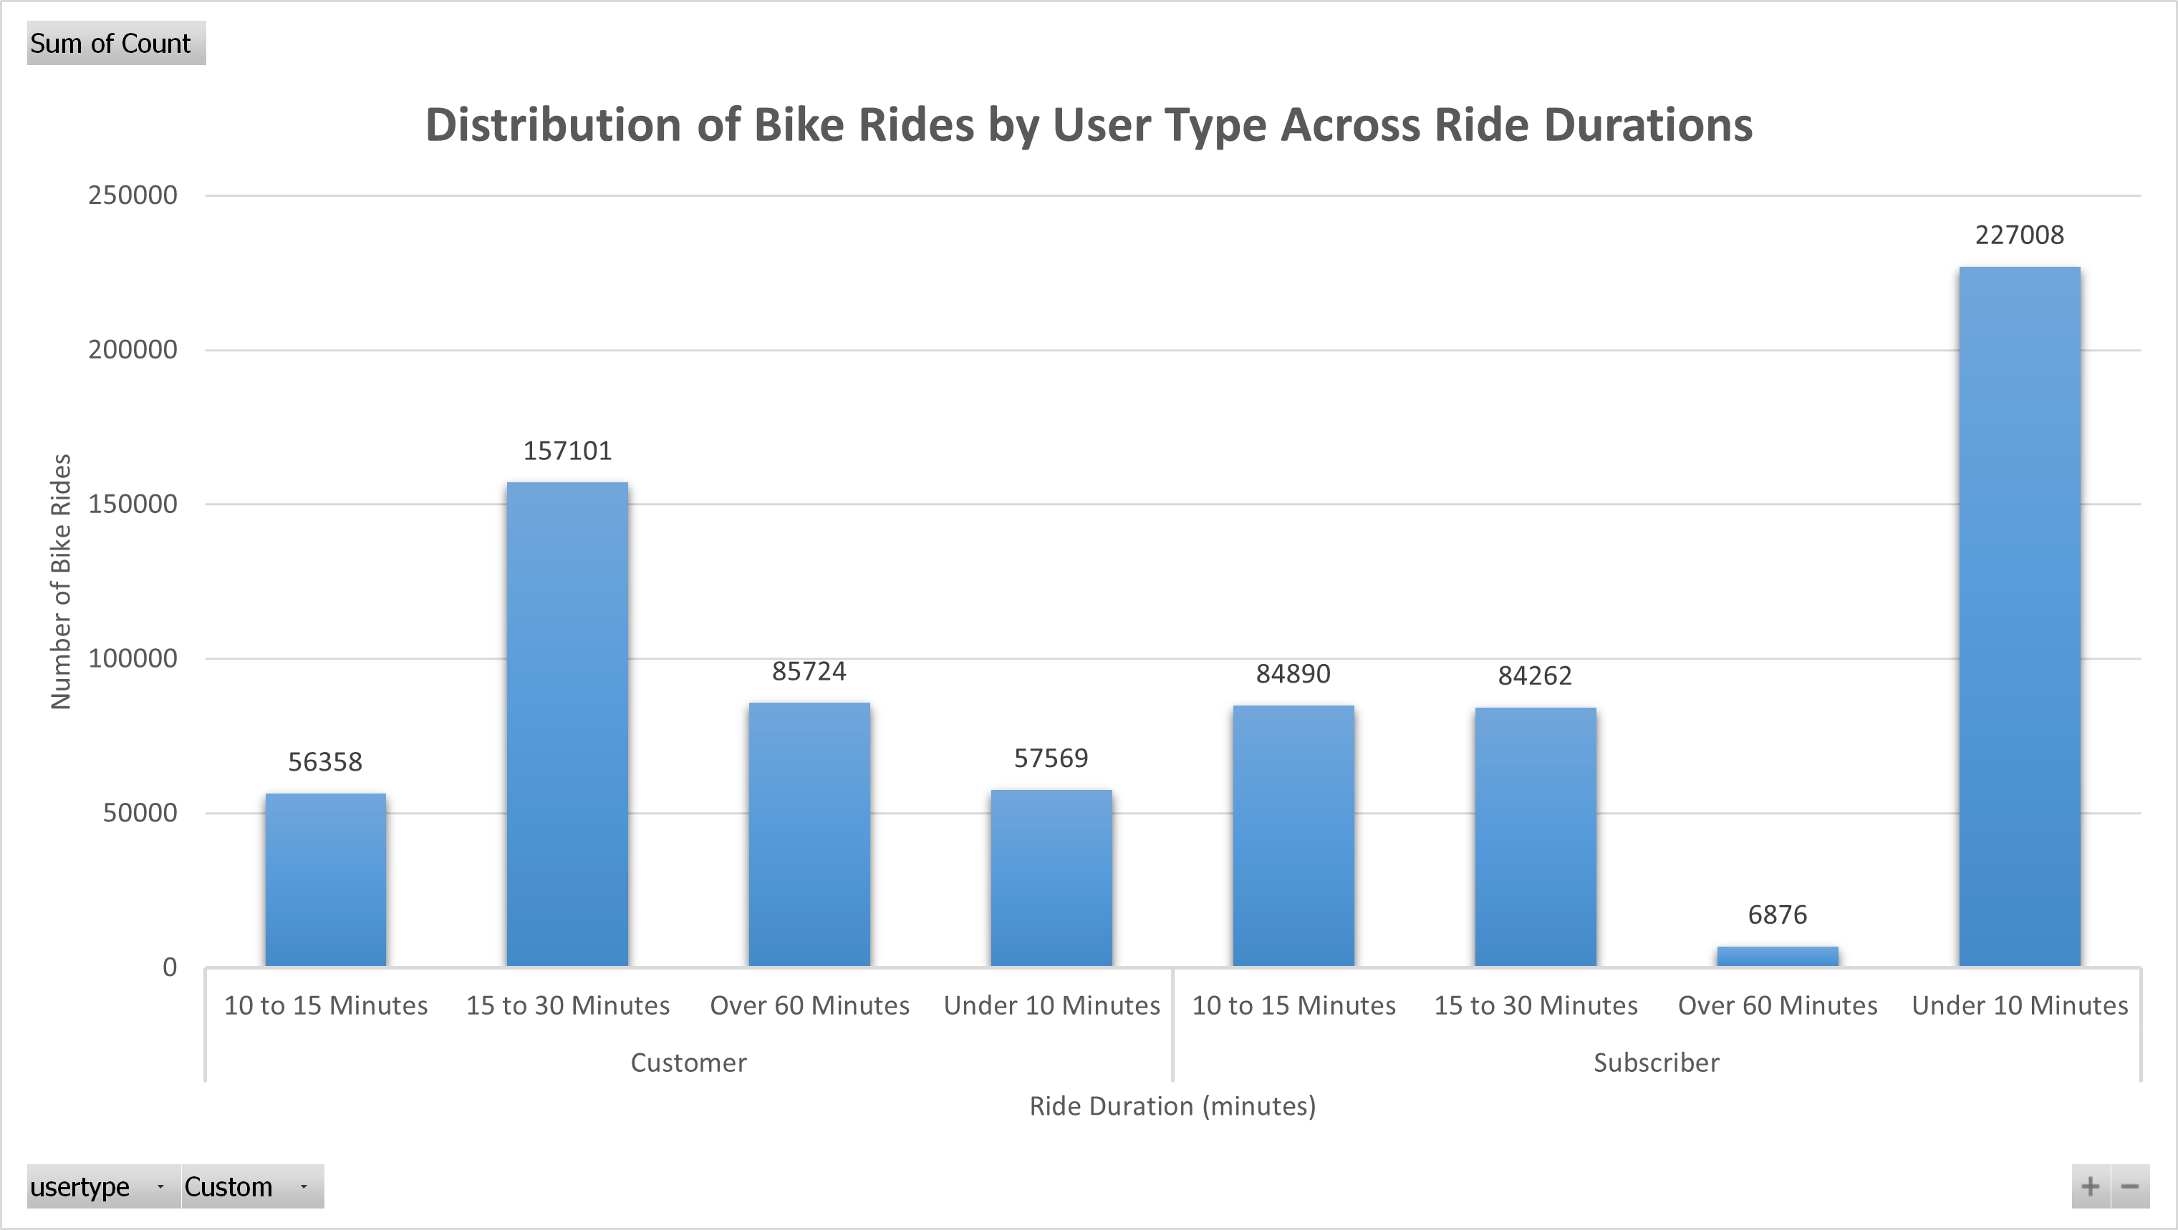

Slide 22
Observed Trends / Key Insights:
For casual riders, most rides last between 15 and 30 minutes, with the second-most common trend being rides over 60 minutes. This suggests that casual riders likely use the service for sightseeing or tourism around the city.
For subscribers, the majority of rides are under 10 minutes, followed by rides lasting 10 to 30 minutes.

Slide 23
Key Finding #1: Ride Duration
Casual users : ~ 30 min per ride
Members : ~ 12 min per ride
Insight : Leisure vs. commute behavior

Slide 24
Key Finding #2: Weekly Usage Patterns
Casual users : Peak on weekends (esp. Saturday)
Members : Peak on weekdays
Insight : Leisure-driven vs. commuter patterns

Slide 25
Key Finding #3: Hourly Trends
Casual users : Peak during midday and evenings
Members : Peak at 7 to 9 am & 3 to 7 pm
Insight : Leisure use vs. work commutes

Slide 26
Recommendation #1:
Monthly Seasonal Subscriptions:
Introduce "Monthly Seasonal Subscriptions" during October, November, and December—when casual ridership is high. This approach could incentivize casual riders to purchase monthly subscriptions, potentially converting them into annual members over time.

Slide 27
Recommendation #2:
Weekend Hangout Subscriptions:
Introduce 'Weekend Hangout Subscriptions' to convert casual leisure riders into weekly subscribers.

Slide 28
Recommendation #3:
24-Hour Mobility Subscription:
Introduce a "24-Hour Mobility Subscription" pass to convert casual leisure and tourist riders into daily members, generating surplus revenue. This approach would also increase the likelihood of these users upgrading to Weekend, Seasonal, or even Annual memberships after experiencing the benefits of subscription-based commuting year-round.

Slide 29
Thank You
Questions?
Prepared by Altamash Ali | Cyclistic Data Analysis

Slide 30

Appendix #1
Row Labels | Average of ride_length
Customer | 0.00.30.24
Subscriber | 0.00.12.02
Grand Total | 0.00.20.39
Row Labels | Sum of Count
6 | 4005
7 | 74867
8 | 170508
9 | 201030
10 | 174695
11 | 90010
12 | 44673
Grand Total | 759788
Row Labels | Sum of Count
6 | 4005
Customer | 3120
Subscriber | 885
7 | 74867
Customer | 51548
Subscriber | 23319
8 | 170508
Customer | 110101
Subscriber | 60407
9 | 201030
Customer | 105335
Subscriber | 95695
10 | 174695
Customer | 64201
Subscriber | 110494
11 | 90010
Customer | 18065
Subscriber | 71945
12 | 44673
Customer | 4382
Subscriber | 40291
Grand Total | 759788
Count of trip_id | Column Labels
Row Labels | Monday | Tuesday | Wednesday | Thursday | Friday | Saturday | Sunday | Grand Total
Customer | 41866 | 32807 | 30221 | 33599 | 47721 | 90575 | 79963 | 356752
Subscriber | 64042 | 69896 | 66828 | 63272 | 67643 | 38862 | 32493 | 403036
Grand Total | 105908 | 102703 | 97049 | 96871 | 115364 | 129437 | 112456 | 759788
Average of ride_length | Column Labels
Row Labels | Monday | Tuesday | Wednesday | Thursday | Friday | Saturday | Sunday | Grand Total
Customer | 0.00.29.26 | 0.00.27.37 | 0.00.27.52 | 0.00.29.41 | 0.00.29.57 | 0.00.32.01 | 0.00.31.44 | 0.00.30.24
Subscriber | 0.00.11.48 | 0.00.11.42 | 0.00.11.39 | 0.00.11.51 | 0.00.11.53 | 0.00.13.21 | 0.00.13.03 | 0.00.12.02
Grand Total | 0.00.18.46 | 0.00.16.47 | 0.00.16.42 | 0.00.18.02 | 0.00.19.21 | 0.00.26.25 | 0.00.26.20 | 0.00.20.39

Slide 31
Appendix #2
Customer | 356752
0 | 4591
1 | 2903
2 | 1954
3 | 1156
4 | 682
5 | 821
6 | 1954
7 | 4716
8 | 8806
9 | 11569
10 | 17829
11 | 24978
12 | 28708
13 | 30797
14 | 32230
15 | 32737
16 | 32156
17 | 31148
18 | 25259
19 | 19182
20 | 13880
21 | 11650
22 | 10069
23 | 6977
Subscriber | 403036
0 | 2714
1 | 1582
2 | 947
3 | 561
4 | 704
5 | 2593
6 | 11393
7 | 29807
8 | 41430
9 | 20403
10 | 14196
11 | 17700
12 | 21463
13 | 20198
14 | 17969
15 | 21529
16 | 34639
17 | 52551
18 | 33709
19 | 20942
20 | 13933
21 | 10192
22 | 7435
23 | 4446
Row Labels | Sum of Count
Customer | 356752
10 to 15 Minutes | 56358
15 to 30 Minutes | 157101
Over 60 Minutes | 85724
Under 10 Minutes | 57569
Subscriber | 403036
10 to 15 Minutes | 84890
15 to 30 Minutes | 84262
Over 60 Minutes | 6876
Under 10 Minutes | 227008
Grand Total | 759788

